Slide 1


Shirley Cooper OBE
Crown Representative Small Business
Procurement Act 2023 - update
Transforming Public Procurement

Slide 2

Shirley Cooper OBE - Agenda
Introduction
Transforming Public Procurement - Key Aims
The Procurement Act – Observations 1 yr live
Opportunities for SMEs and VCSEs
Q&A

Slide 3
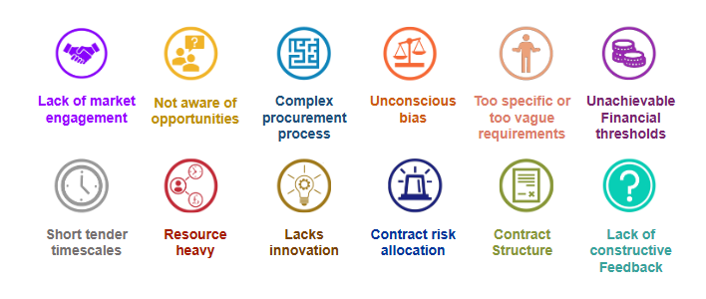
Barriers to Address
3

Slide 4
Transforming Public Procurement - key aims
The key aims:
  Creating a simpler and more flexible, commercial system that better meets our country’s needs while remaining compliant with our international obligations
  Opening up public procurement to new entrants
  Taking tougher action on underperforming suppliers and excluding suppliers who pose unacceptable risks
  Embedding transparency throughout the commercial lifecycle

Slide 5
How the Procurement Act benefits suppliers
A duty on contracting authorities to have regard to the fact that SMEs may face barriers to participation. In practice this could mean:
  considering the format of preliminary market engagement
  avoiding short timescales for bidders to submit requests or tenders
  providing good quality feedback to unsuccessful bidders
Central Digital Platform (CDP) – all opportunities in one place
  storing and sharing ‘core supplier information’
Greater transparency - e.g. Notices signposting preliminary market engagement and how suppliers can participate
New “open” frameworks which will be re-opened for new suppliers to join at set points
Fair payment – 30 day payment terms applying contractually throughout the supply chain.

Slide 6
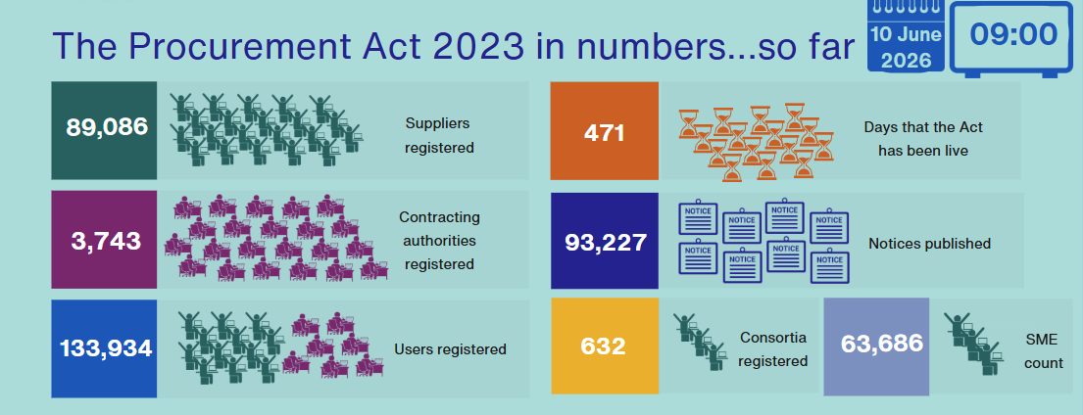
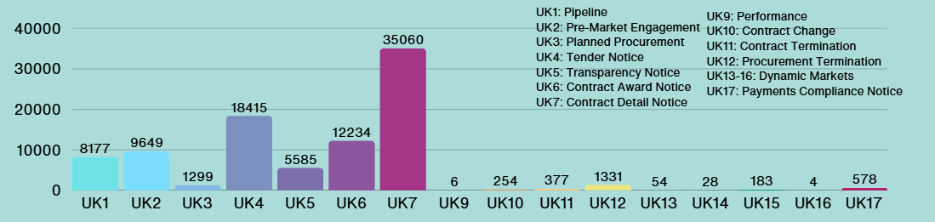
Latest update 10 June: CDP stats

Slide 7
The Procurement Act 2023: Observations, so far…
Public sector pipeline
Increase in pre-tender noticing, identification of known risks
Examples of use of new flexible procedure
Use of data to identify opportunities and inform strategies
Capability focus
Collaboration and Communities of Practice*
*for contracting authorities

Slide 8
National Procurement Policy Statement
The NPPS (Feb 25) sets out strategic priorities for public procurement and how contracting authorities can support their delivery
It stresses that increasing procurement spend with SMEs and VCSEs is a national priority to drive economic growth
From April 25 departments set their own targets for direct spend with SMEs and from April 26 with VCSEs too.
SME Action Plans and targets live on departmental website now.

Slide 9
Next steps for you
Understand what the change will bring for your business
Social value, innovation and customer service – all play to your strengths
Supply Chains – a chance to grow
The new Public Procurement Regime offers a fresh opportunity
Register on the CDP, attend Pre Market Engagement and Meet the Buyer events
I’m here to listen and help

Slide 10


Any Questions?

